Slide 1
Hey 👋🏾

Slide 2
Guess what? 👀🫣

Slide 3
Let’s get our heads active 🤘🏽

Slide 4

The accessibility of the web with JAMstack.
Opemipo Disu
— @coderoflagos

Slide 5
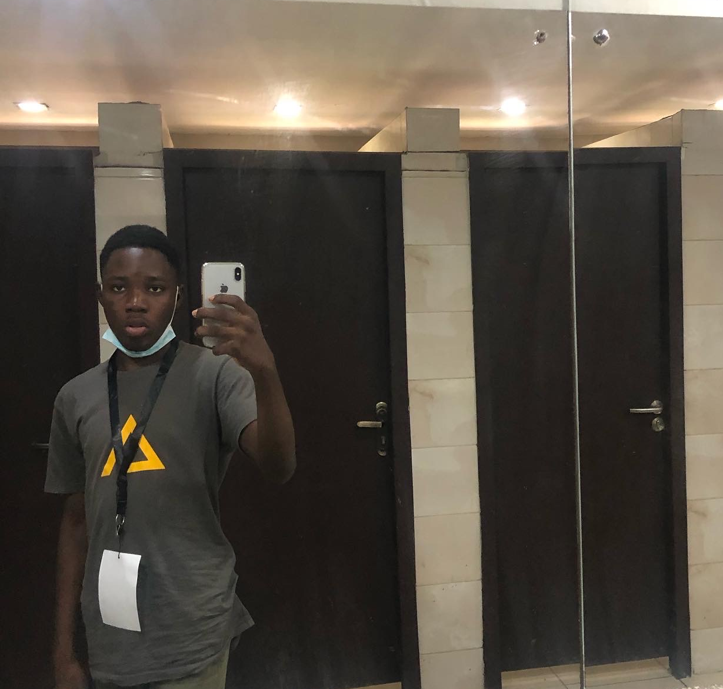
Meet Opemipo Disu
16-year-old Developer Advocate, and Application Architect.
Currently works for ‘no company’ as a Developer Advocate. 😂
Keynote Speaker, IBM Champion & Couchbase Champion, Keboola Expert, and so many things.
Opemipo Disu
— @coderoflagos

Slide 6


Slide 7
Oh, right! Forgot to share, I love exploring new stuffs, and got into tech at 11 🤯🤷🏽‍♂️

Slide 8
What’s JAMstack? 🧐

Slide 9
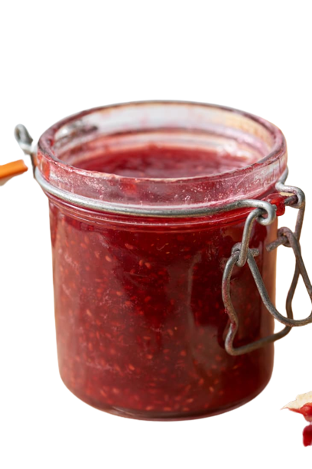
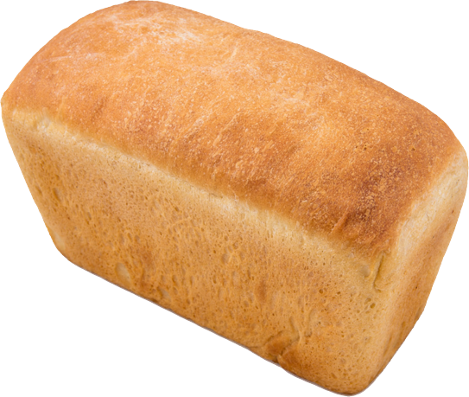
WTF is JAMstack? 😏
Let’s get the cats out of the bag! 🤩
JAMstack is a modern architecture of the web designed to make the web faster, secure, scalable and even pretty much accessible. It builds on the tools Devs love and brings maximum productivity.
There are stuffs that makes up the JAMstack! 🫣

Slide 10
Now - let’s get back to the web without JAMstack! 🫠

Slide 11
JAMstack is the new standard architecture for the web. All it does is that it makes the web pretty much faster, secure, accessible, scalable and even portable.
P.S: JAMstack is a frontend stuff :)

Slide 12
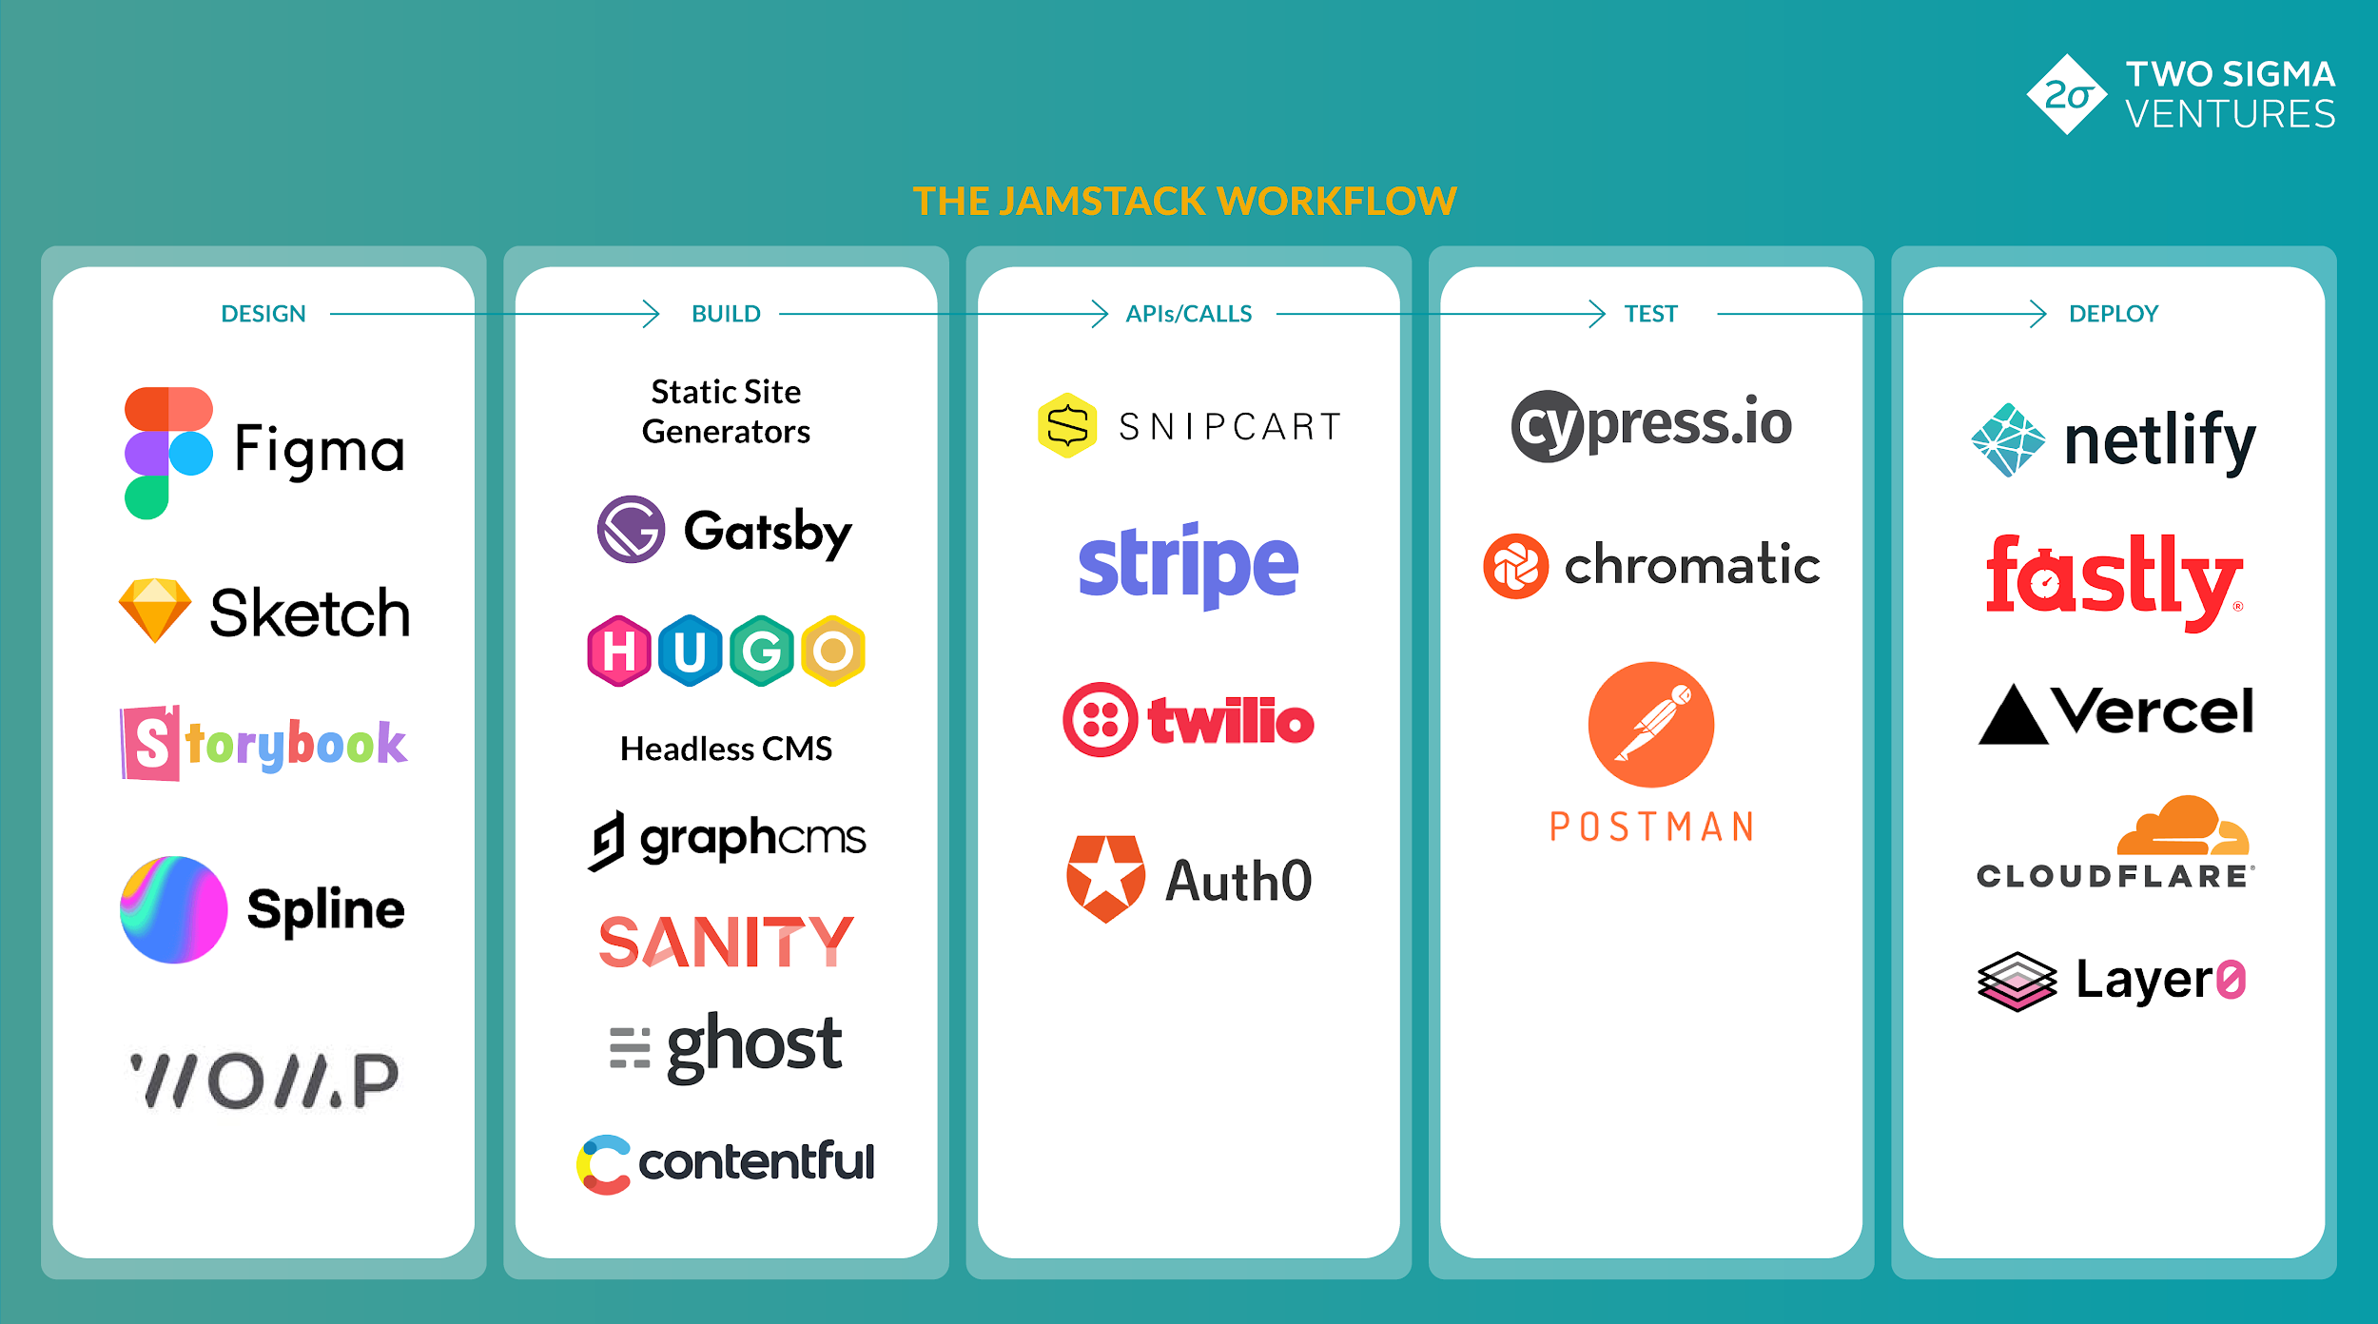

Slide 13
How do I get started with JAMstack?
What are the tools needed to get started with JAMstack?
JAMstack is pretty easy stuff to get started with.
The required stuffs for you to know before getting into JAMstack are:
JavaScript
You need to have a basic knowledge of how frontend tools work.
That’s all you need to know, nothing much. Then you get start full work.

Slide 14
Ways Developers have made JAMstack accessible in the past 7 years.
Headless CMS’.
Open source frameworks like SvelteKit.
Modern Build Tools.
Automated builds.
The entire project you’ve made is all on a CDN.

Slide 15
JAMstack’s accessibility ⚡️

Slide 16
Why you should get into JAMstack 🛸🤔
What’s so special about JAMstack?
Trust me, there’s a lot special about JAMstack. Apart from the stuffs I’d be mentioning soon, JAMstack has a community for all cities, a community where JAMstack Developers come together to share ideas on what they are working on, and other JAMstack related stuffs.

Slide 17
What makes up the JAMstack 🛸🤔
Scalability.
Portability.
Developer Experience.
Hosting and Maintenance
Fast performance.
Security.

Slide 18
JAMstack as the best stuff on Web 2.0
Well, maybe the best stuff :)
Obviously, it’s one of the best things in Web 2. Using all these frameworks makes things pretty much easy for developers and users. It gives better DX and UX, JAMstack sites are pretty fast and scalable and easy to maintain. Everything you need will be on a CDN.

Slide 19
JAMstack = easy
🤷🏽‍♂️

Slide 20
Thank you!
❤️🙏🏽
Opemipo Disu
— @coderoflagos

